Slide 1
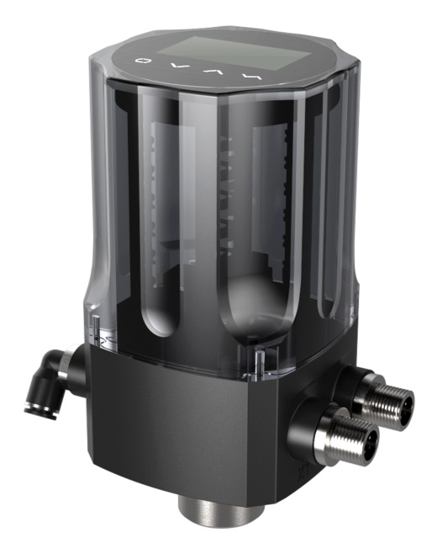
1880 Series Intelligent Valve Positioner
Compact design
OLED display
Easy to start-up
Ex nA explosion proof
Technical data
Material | PC、PA6-GF30、SI
Power supply | 24V DC ±10%
Set-point signal | 0/4-20mA
Input resistance for set-point signal | 120Ω
Control medium Dust concentration Particle density Pressure condensation point Oil concentration | neutral gases, air DIN ISO 8573-1 Solid particle size and density Class 3 Dew point Class 3 Oil content Class 3
Ambient temperature | 0-70°C
Pneumatic connection | Plug-in hose connector G1/4(internal Φ6mm
Electrical connection | M12 2-pins B-coded(cable ø 4-6mm) M12 4-pins D-coded(cable ø 4-6mm)
Supply pressure | 3~7 bar, specific values depending on the actuator
Air flow rate | 17 l/min(input pressure of 0.6Mpa)
Stroke control range | Line 5-25mm
Installation | As required, Preferably with actuator in upright position, Screw
Protection class | IP66
Power consumption | <5W
Explosion-proof class | Ex nA II C T4
1880 series intelligent valve positioner is compact designed controller for integral pneumatic control valves.
The product is easy to operate and has rich software functions.
It can easily be operated via the OLED display and keypad.
The positioner adjusts the valve position quickly and accurately through detecting the position sensor signal.

Slide 2
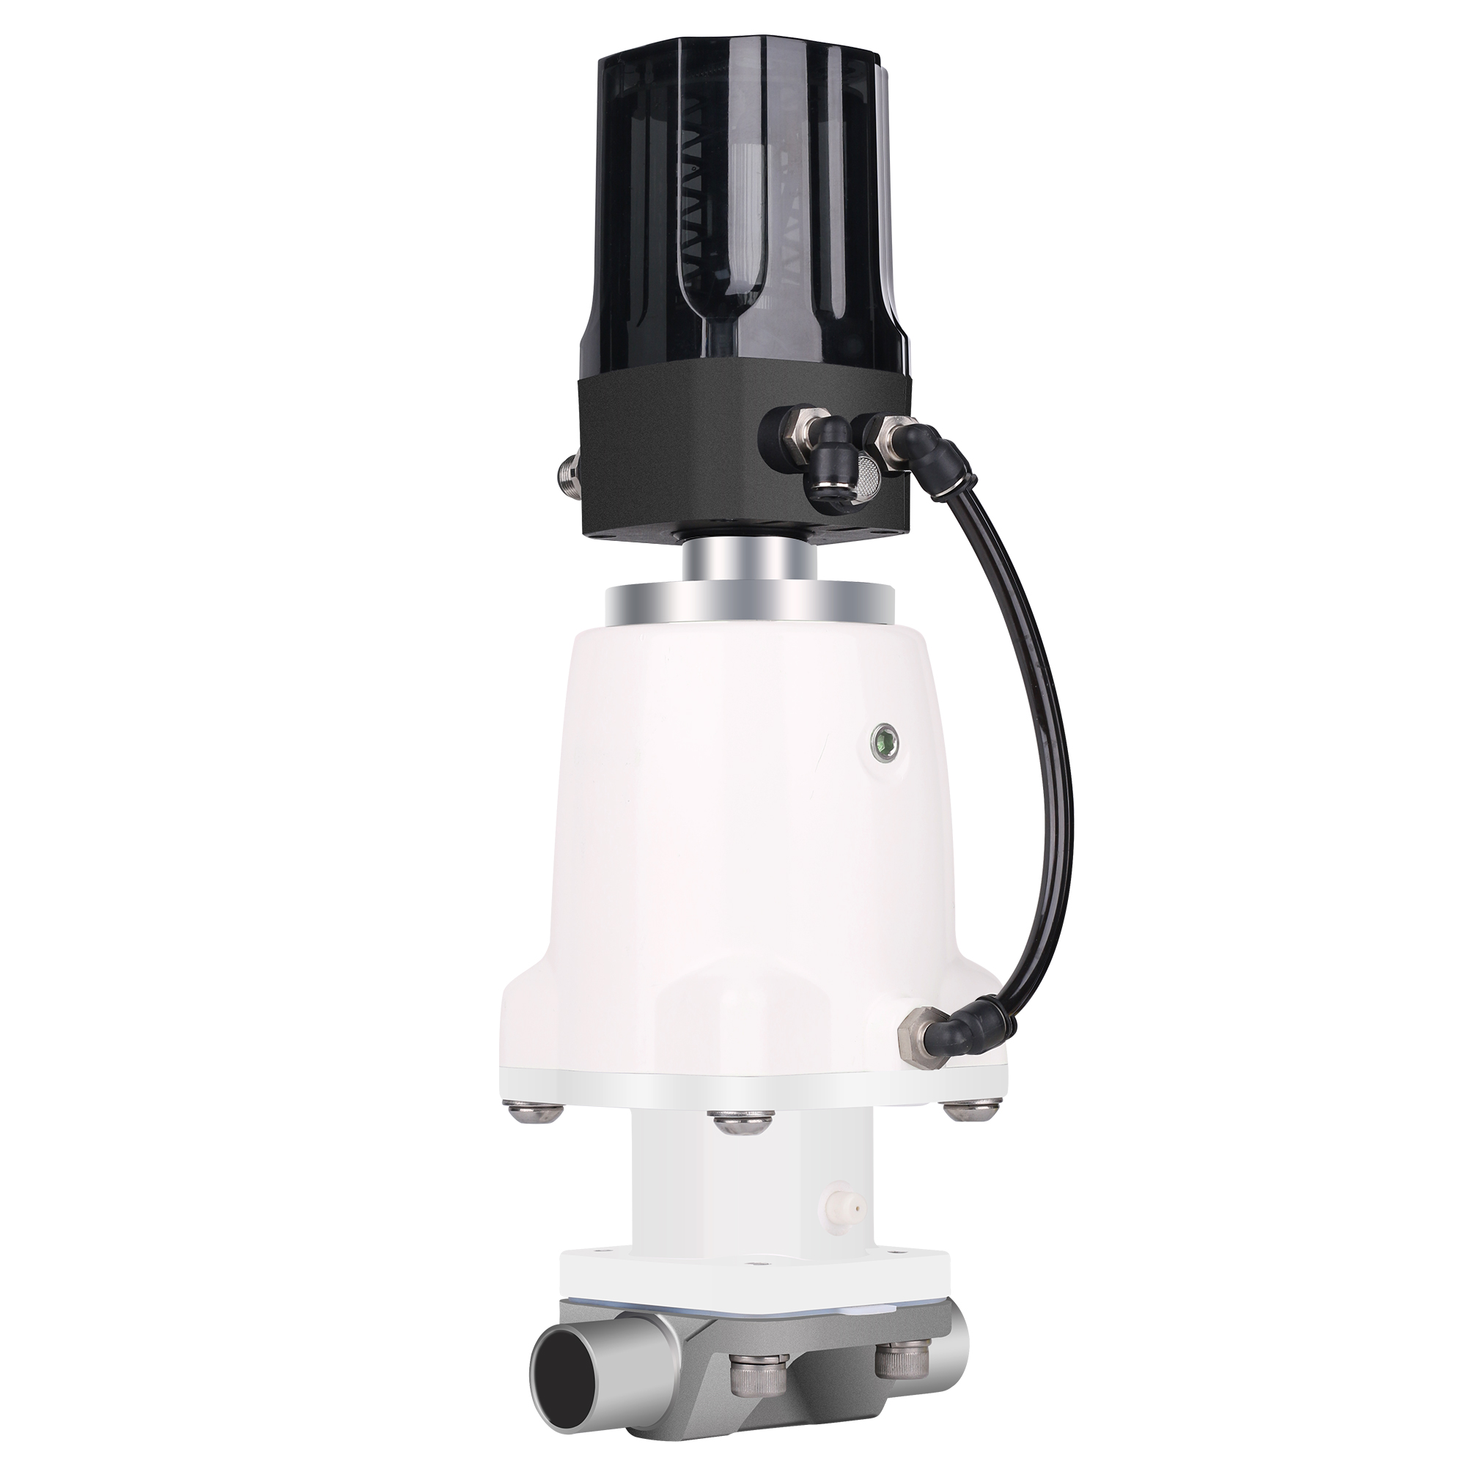
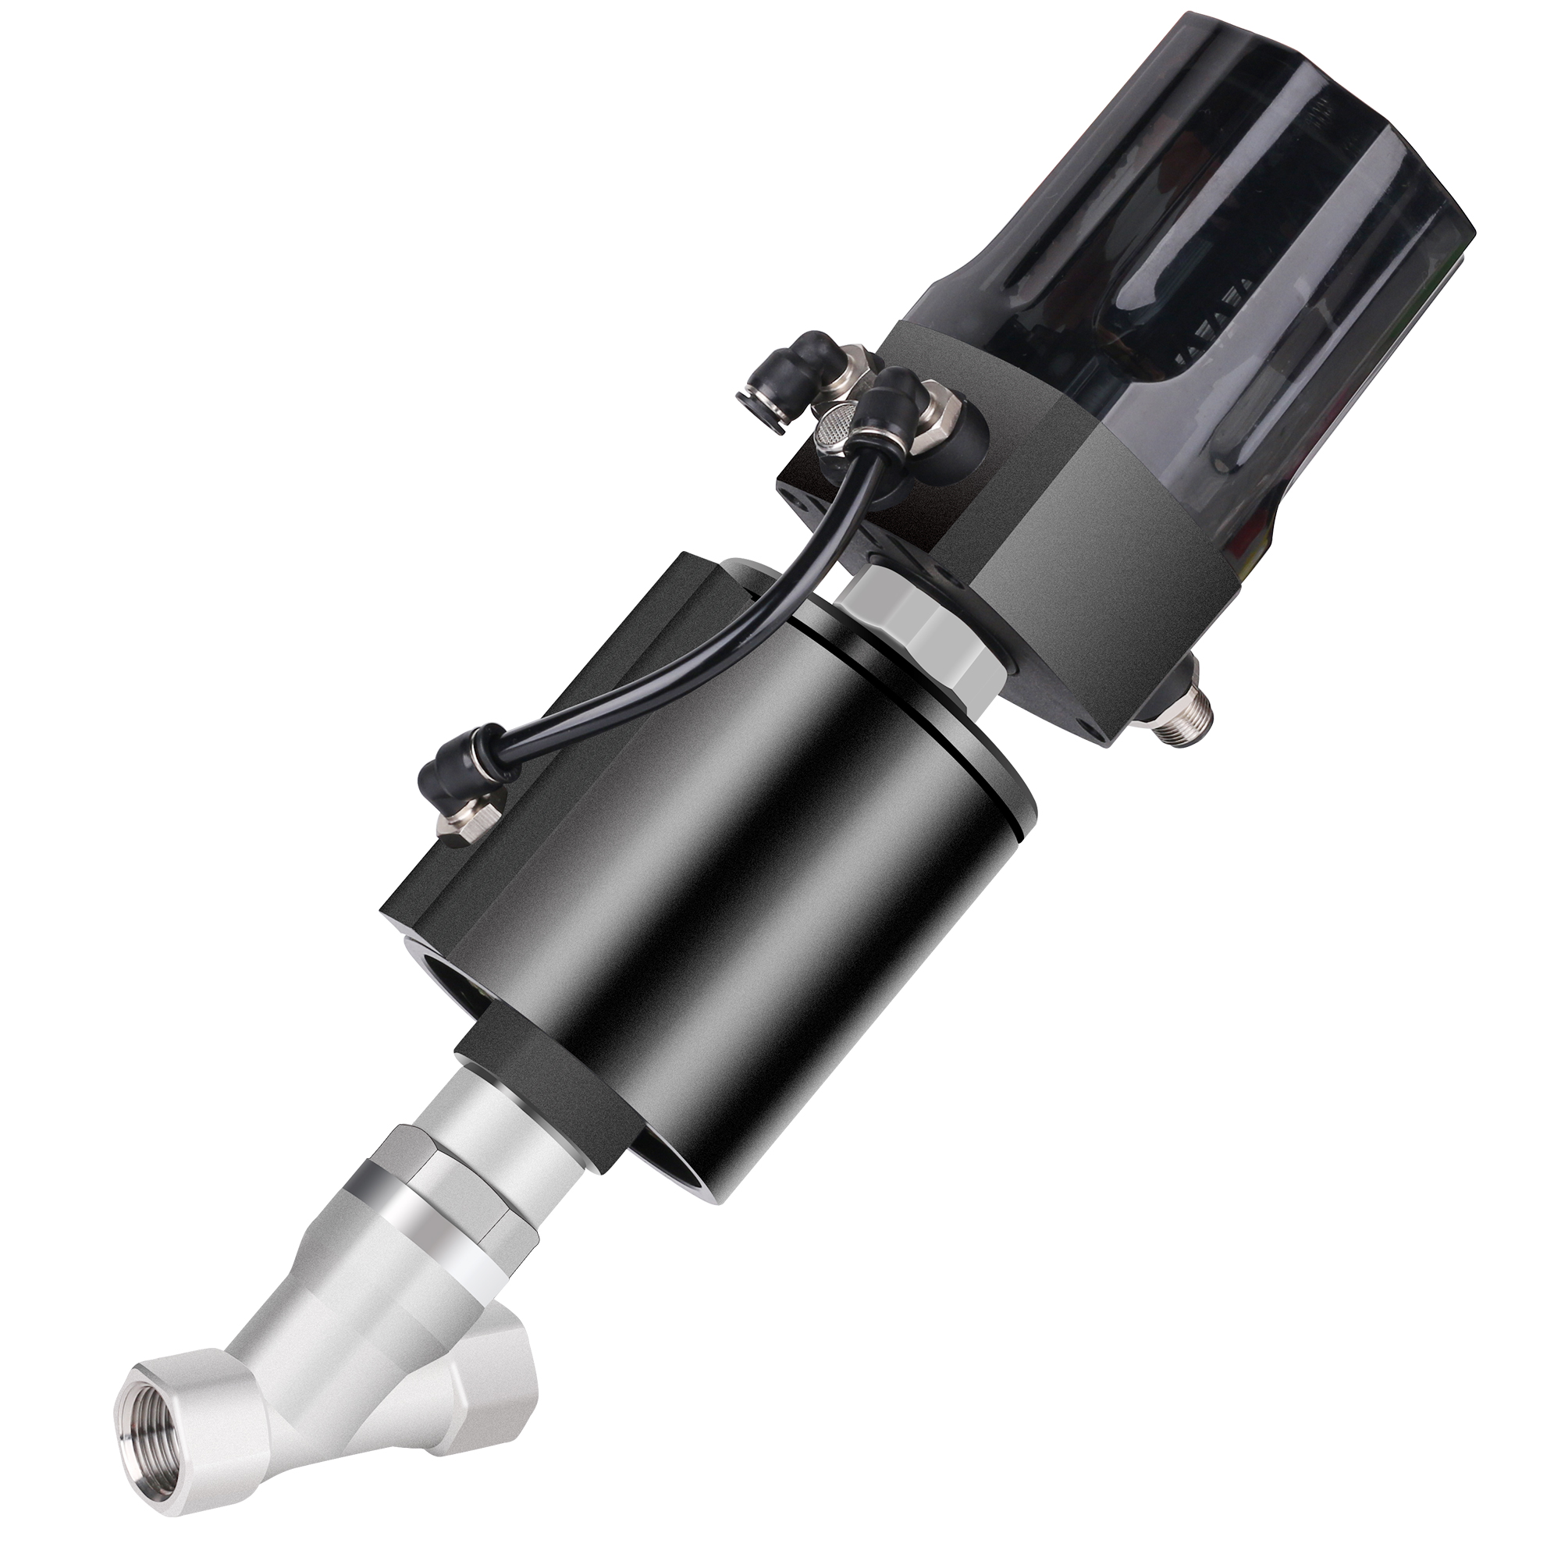
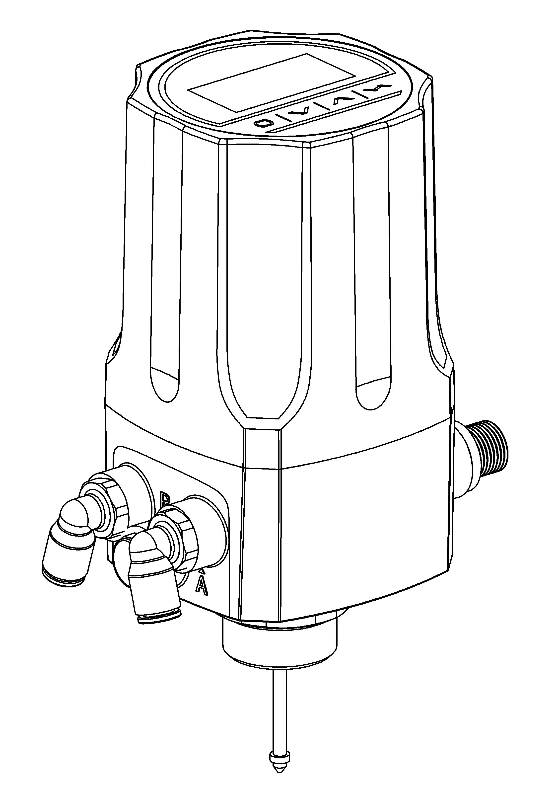
Combinations
Diaphragm control valve
Angle seat control valve
Structure
1
2
Display screen and key panel
Transparent body casing
Main body casing
Electrical connection
Pneumatic connection
Actuator connection
3
4
6
5

Slide 3
Technical specifications
N No feedback signal
Y 4-20mA feedback signal
Feedback signal
T1 G1/4
T2 M16 * 1
T3 M22 * 1.5
T4 M26 * 1.5
Thread type
1880
N
T1
Remark:
The product is only used for single-acting line stroke actuator. Fail-safe when power-off.It is suggested to match the actuator of 40-100 mm internal gas chamber diameter.

Slide 4
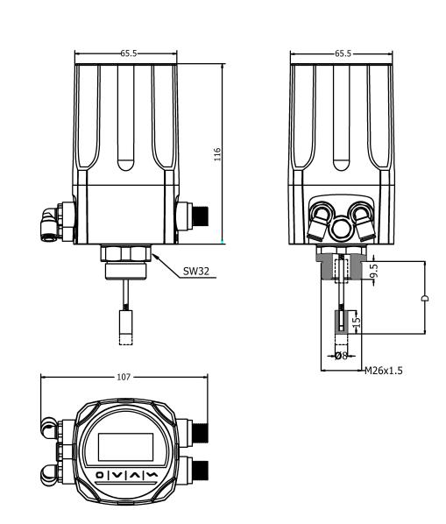
Dimensions

Slide 5
Interface angle adjustment
The angle can be adjusted between the positioner and the valve. If need to adjust the interface angle, rotate the main body casing clockwise or counter-clockwise in 180°range.
180°
180°

Slide 6
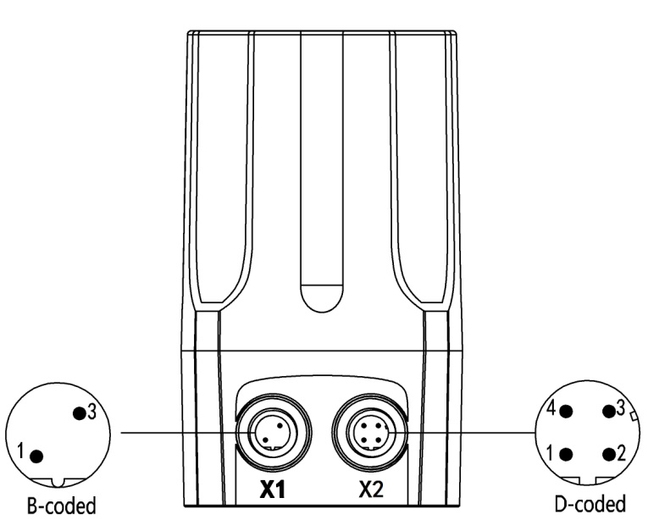
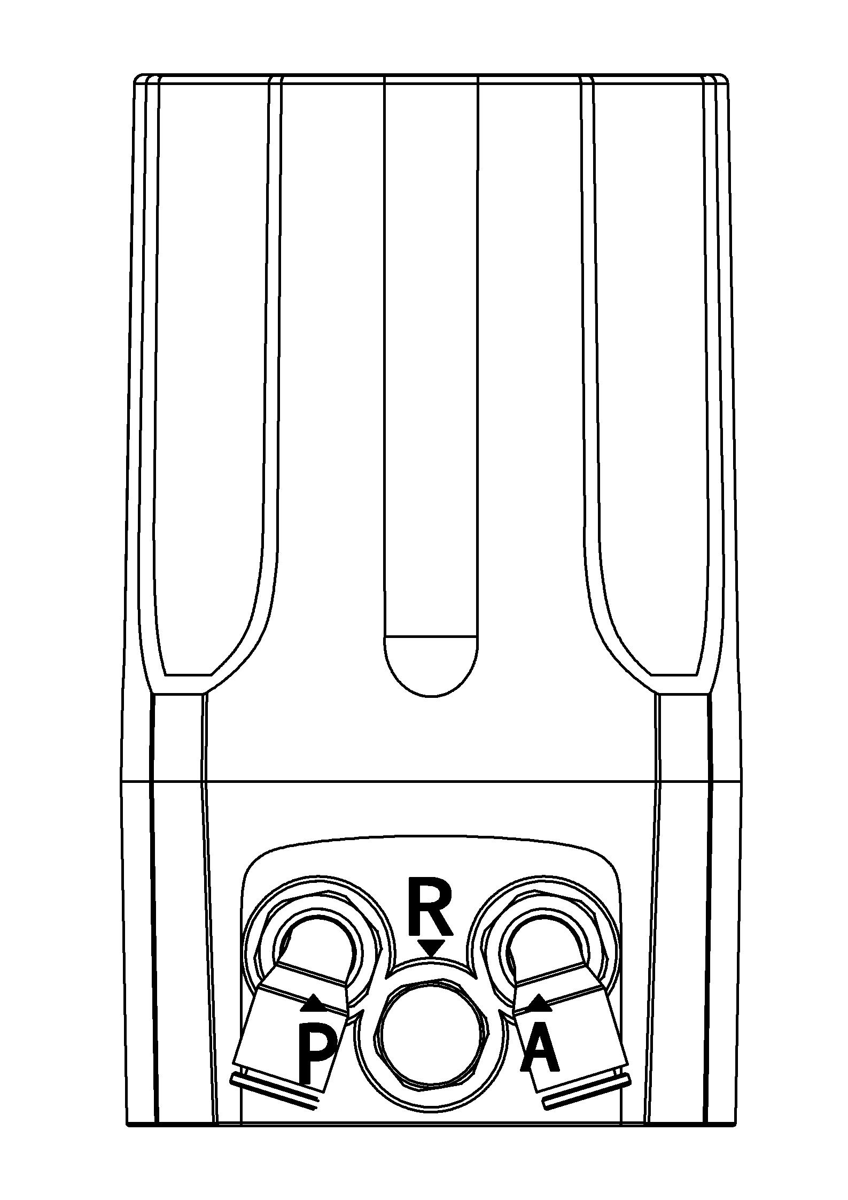
Electrical connections and pneumatic connections
X1
Pin | Description | Signal type
1 | Analogue signal output + | 0/4 – 20 mA
3 | Analogue signal output GND | GND
X2
Pin | Description | Signal type
1 | Power supply + | +24 V
2 | Power supply GND | GND
3 | Set signal input + | 0/4 – 20 mA
4 | Set signal input GND | GND
P | Air supply enter(built-in filter, filter size 5 μm)
R | Air exhaust
A | Pilot air outlet

Slide 7
Additional software functions
Selection of the transfer characteristic between set-point value and stroke.
Sealing function for position controller.
Effective sense of direction between input signal and set-point value.
Limit of the mechanical stroke range.
Setting for control parameters.
Safety position setting for the position controller.
Configuration of signal level fault detection.
Configuration of the outputs.
Calibrating the control parameters.
Setting for manual control rate.
Code protection.
Schematic diagram
Operation through keypad
Inputs
Outputs
Set-point signal
4-20mA, 0-20mA
Positioner
Analogue signal
4-20mA, 0-20mA
Power supply
24V DC

Slide 8
Function comparison for all types
FUNCTION | 1600 | 1601 | 1500 | 1880
Explosion-proof | √ | √ | × | √
Process control | × | √ | × | ×
4-20mA signal input | √ | √ | √ | √
4-20mA signal output | ○ | ○ | ○ | ○
Autotune | √ | √ | √ | √
Valve position manual adjustment | √ | √ | √ | √
Sealing function | √ | √ | √ | √
Dead band setting | √ | √ | √ | √
4-20mA input signal error detection | √ | √ | √ | √
Factory setting | √ | √ | √ | √
Characteristic curve setting | √ | √ | × | √
Direction of set-point value | √ | × | × | √
Valve stroke range limiting | √ | √ | × | √
Safety position setting | √ | √ | × | √
Binary signal input/output | √ | √ | × | ×
Input signal calibration | √ | √ | × | √
Speed setting of manual adjustment | √ | √ | × | √
Code protection | √ | √ | × | √
√ | YES
× | NO
○ | optional

Slide 9
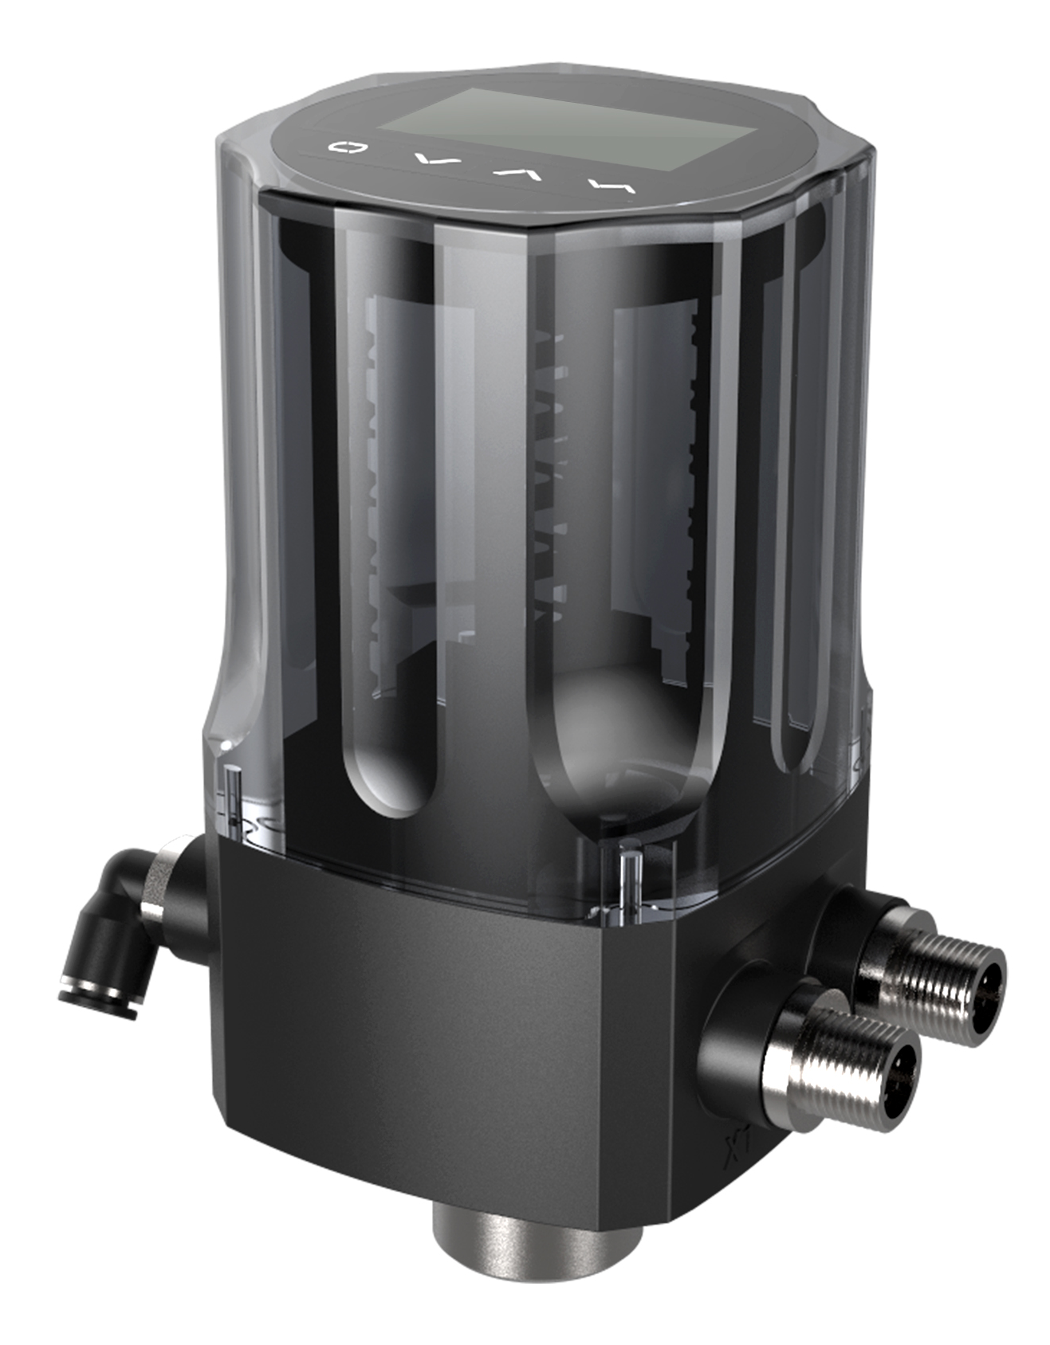
1880系列智能电气阀门定位器
外形小巧紧凑
OLED显示屏
快速简易启动
Ex nA 防爆
技术参数
材料 | 聚碳酸脂（PC）硅橡胶(SI) 聚酰胺(PA6-GF30）
电源 | 直流 24V ±10%
信号输入 | 0/4 - 20mA
设定信号输入阻抗 | 120Ω
压缩空气要求 颗粒度要求 颗粒密度要求 凝点要求 油脂浓度要求 | 中性气体, 符合 DIN ISO 8573-1 要求 固体颗粒大小和密度 3 级 露点 3 级 含油量 3 级
环境温度 | 0-70°C
气动接头 | 1/4英寸插入式软管接头(内径Φ 6mm)
电气快速接头 | M12 二针 B标准(电缆直径ø 4-6mm) M12 四针 D标准(电缆直径ø 4-6mm)
气源压力 | 3-7 bar，具体值视执行机构而定
气体输出流量 | 17 l/min(输入压力为0.6Mpa)
阀门行程控制范围 | 直行程 5-30 mm
安装方式 | 倾向于安装在执行器顶端，通过螺纹和执行器连接
防护等级 | IP66
功耗 | <5W
防爆等级 | Ex nA II C T4
1880系列智能电气阀门定位器是专为一体式气动调节阀所设计的，特别适用于角座阀和隔膜阀产品。
该产品操作简便，软件功能丰富，可轻松通过显示屏和按键面板进行操作。
定位器可通过检测位移传感器信号，对阀位进行快速精确调节。

Slide 10
组合方式
隔膜式调节阀
角座式调节阀
产品结构
1
显示屏和按键面板
透明外壳
主壳体
电气接口
气动接口
执行器连接件
2
3
4
5
6

Slide 11
技术规格
N 无反馈信号
Y 4-20mA反馈信号
反馈信号
T1 G1/4
T2 M16 * 1
T3 M22 * 1.5
T4 M26 * 1.5
螺纹规格
1880
N
T1
备注：
该产品只适用于单作用直行程执行器。断电状态为复位。建议匹配气室内径40-100 mm的执行器。

Slide 12
机械尺寸

Slide 13
操作界面角度调整
将定位器与阀门连接之后，定位器可与阀门之间做角度调整。若需要调整定位器操作界面角度，可以顺时针或逆时针180°范围内旋转主壳体到需要的角度。
180°
180°

Slide 14
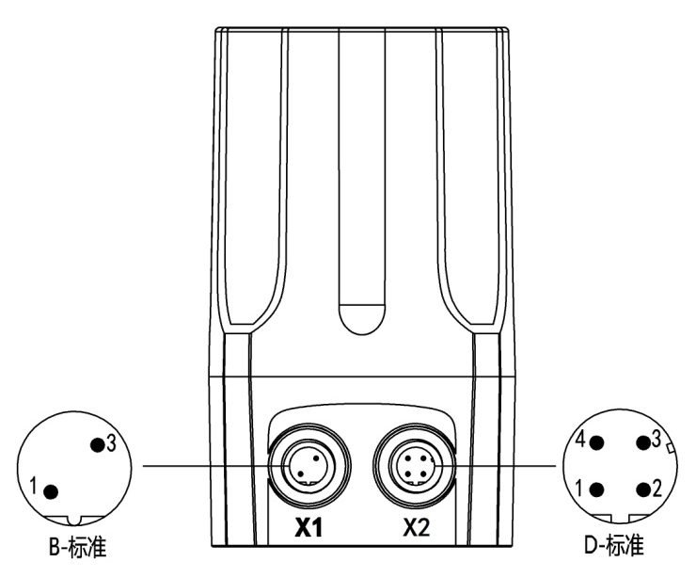
电气接口和气动接口
X1
端子号 | 描述 | 信号类型
1 | 模拟信号输出 + | 0/4 – 20 mA
3 | 模拟信号输出 GND | GND
X2
端子号 | 描述 | 信号类型
1 | 电源 + | +24 V
2 | 电源GND | GND
3 | 设定信号输入 + | 0/4–20mA
4 | 设定信号输入GND | GND
P | 气源进入（内置滤网，过滤尺寸5μm）
R | 排气
A | 先导气口

Slide 15
软件附加功能
阀门传输特性设置
紧闭功能设置
输入信号和设定值间的作用方向设置
阀门行程限制
密码保护功能
控制参数的设置
安全位置的设置
输入信号错误检测
输出信号功能配置
控制参数校正
手动控制速度设置
密码保护
原理图
面板操作
输入
输出
设定信号
4-20mA, 0-20mA
定位器
模拟量信号
4-20mA, 0-20mA
电源
24V 直流

Slide 16
各型号功能对比
功能 | 1600 | 1601 | 1500 | 1880
防爆 | √ | √ | × | √
过程控制 | × | √ | × | ×
4-20mA信号输入 | √ | √ | √ | √
4-20mA信号输出 | ○ | ○ | ○ | ○
自整定 | √ | √ | √ | √
手动调节阀位 | √ | √ | √ | √
紧闭功能 | √ | √ | √ | √
死区设置 | √ | √ | √ | √
4-20mA输入信号错误检测 | √ | √ | √ | √
恢复出厂设置 | √ | √ | √ | √
特性曲线设置 | √ | √ | × | √
信号方向设置 | √ | × | × | √
行程限制 | √ | √ | × | √
安全位置设置 | √ | √ | × | √
开关量信号输入/输出 | √ | √ | × | ×
输入信号校正 | √ | √ | × | √
手动调节速度设置 | √ | √ | × | √
密码保护 | √ | √ | × | √
√ | 有该功能
× | 无该功能
○ | 可选

