Slide 1
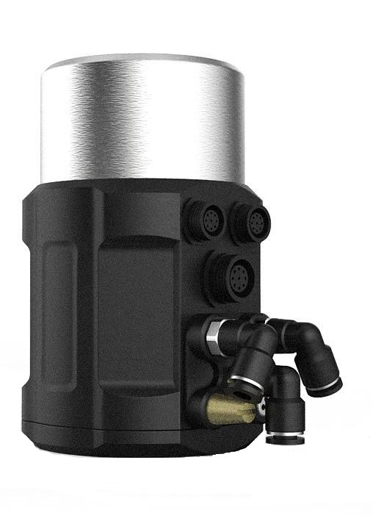
1600 Series Intelligent Electropneumatic
Valve Positioner
1600 Position controller
Process controller
Position controller(Profibus-DP)
Compact stainless steel design
Electrical waterproof connectors
LCD with backlight
Easy to start-up
Rich additional software functions
Technical data
Material | PC、PA6-GF30、Stainless Steel、SI
Power supply | 24V DC ±10%
Set-point signal (1600/1601) | 0/4-20mA or 0-5/10 V
Input resistance for set-point signal (1600/1601) | 240Ω at 0/4-20mA, 21KΩ at 0-5/10V
Control medium Dust concentration Particle density Pressure condensation point Oil concentration | neutral gases, air DIN ISO 8573-1 Solid particle size and density Class 3 Dew point Class 3 Oil content Class 3
Ambient temperature | 0-70°C
Pneumatic connection | Plug-in hose connector G1/4(internal Φ6mm
Electrical connection | M12 3-pins B-coded(cable ø 4-6mm) M12 4-pins D-coded(cable ø 4-6mm) M12 5-pins A-coded(cable ø 4-6mm)
Supply pressure | 3~7 bar, specific values depending on the actuator
Air flow rate | 17 l/min(input pressure of 0.6Mpa) 58 l/min(input pressure of 0.6Mpa ,only single-acting)
Stroke control range | Line 5-50mm Angle 90°
Installation | As required, Preferably with actuator in upright position, Screw
Protection class | IP66
Power consumption | <5W
Explosion-proof class (1600/1601) | Ex nA II C T4
1600 series intelligent electro-pneumatic valve positioner is designed for integral pneumatic control valve, particularly suitable for angle seat valves and diaphr-agm valves.
The product is easy to operate and has rich software functions.
It can easily be operated via the LCD and keypad.
The positioner adjusts the valve position quickly and accurately through detecting the position sensor signal.

Slide 2
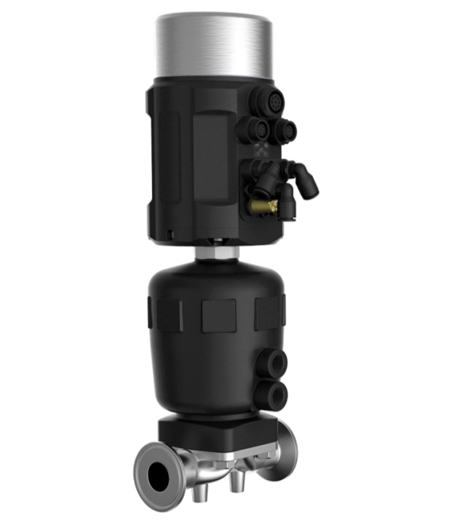
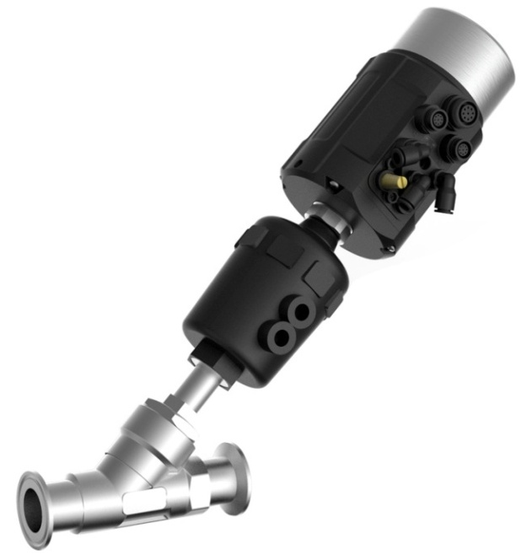
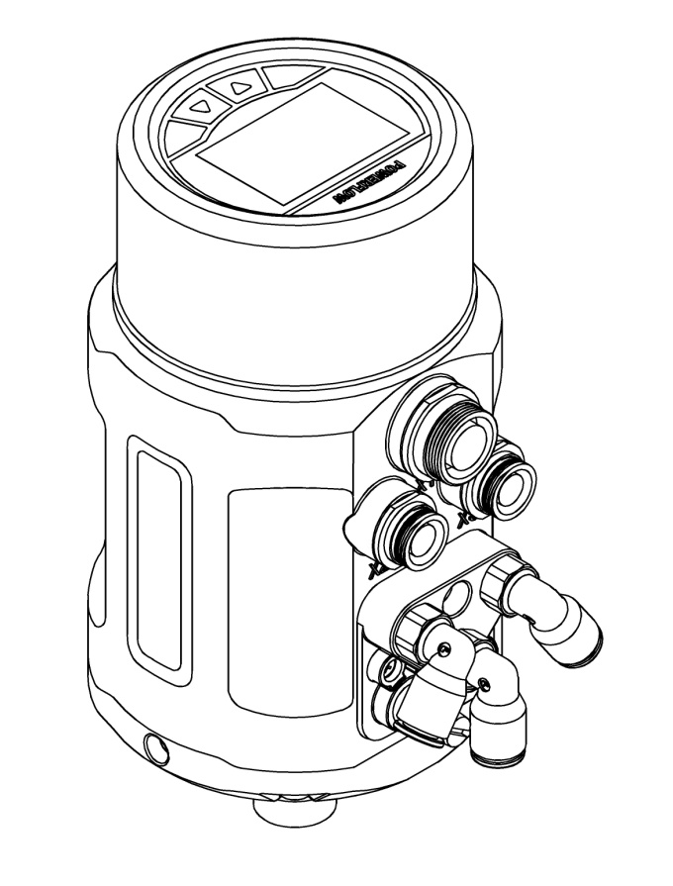
Combinations
Diaphragm control valve
Angle seat control valve
Structure
1
LCD and key panel
Stainless steel body casing
Main body casing
Electrical connection
Pneumatic connection
Actuator connection
2
3
4
5
6

Slide 3
Technical specifications
1600 Without process control function
With process control function
Without process control function (Profibus-DP)
Product series
N No feedback signal
Y 4-20mA feedback signal
Feedback signal
S Single-acting
D Double-acting
Actuator type
S2 Line 5-25 mm
S3 Line 25-50 mm
S4 Angle 90°
Valve max stroke
Q1 17 l/min
Q2 58 l/min
Air flow rate
T1 G1/4
T2 M16 * 1
T3 M22 * 1.5
T4 M26 * 1.5
Thread type
S Safe
F Freeze
Power off state for single-acting
1600
N
S
S2
Q1
T1
S
Remark:
In the air flow rate option, code Q1 is suggested to match the actuator of 40-100 mm internal gas chamber diameter, code Q2 is suggested to match the actuator of 125-160 mm internal gas chamber diameter. Code Q2 is only used for single-acting actuator, and only in Freeze state when power-off. The air flow rates for code Q1 and Q2 are under the condition of 0.6Mpa input pressure.
In the valve max stroke option, AT actuator range for code S4 is AT50~AT125. For other actuator models, please consult our company. It is no need to select the thread type option for code S4.
Power off state for single-acting option is Safe by default.1602 type is without 4-20mA feedback signal.

Slide 4
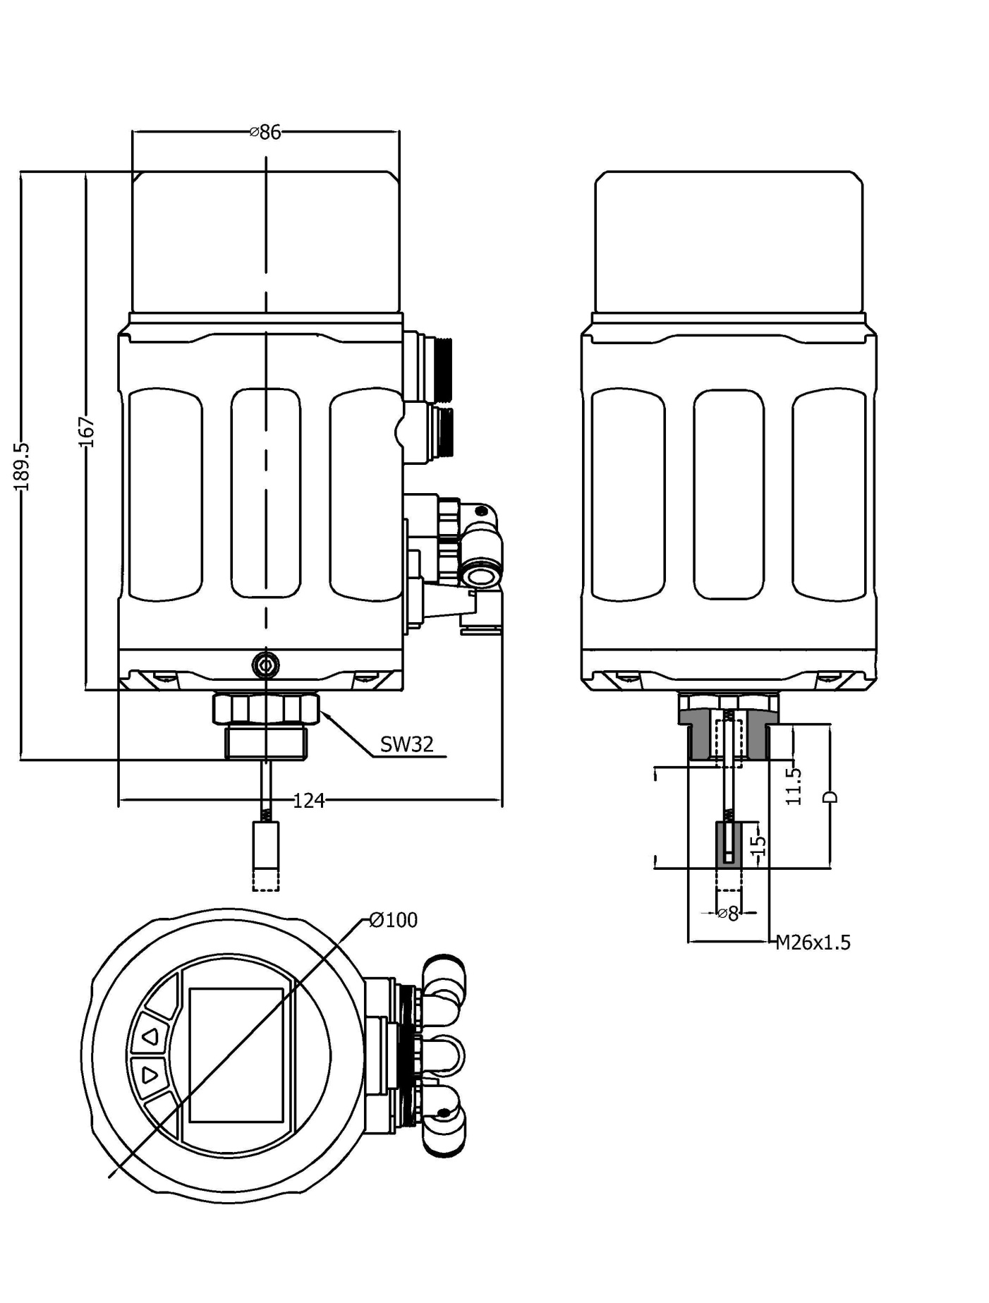
Dimensions

Slide 5
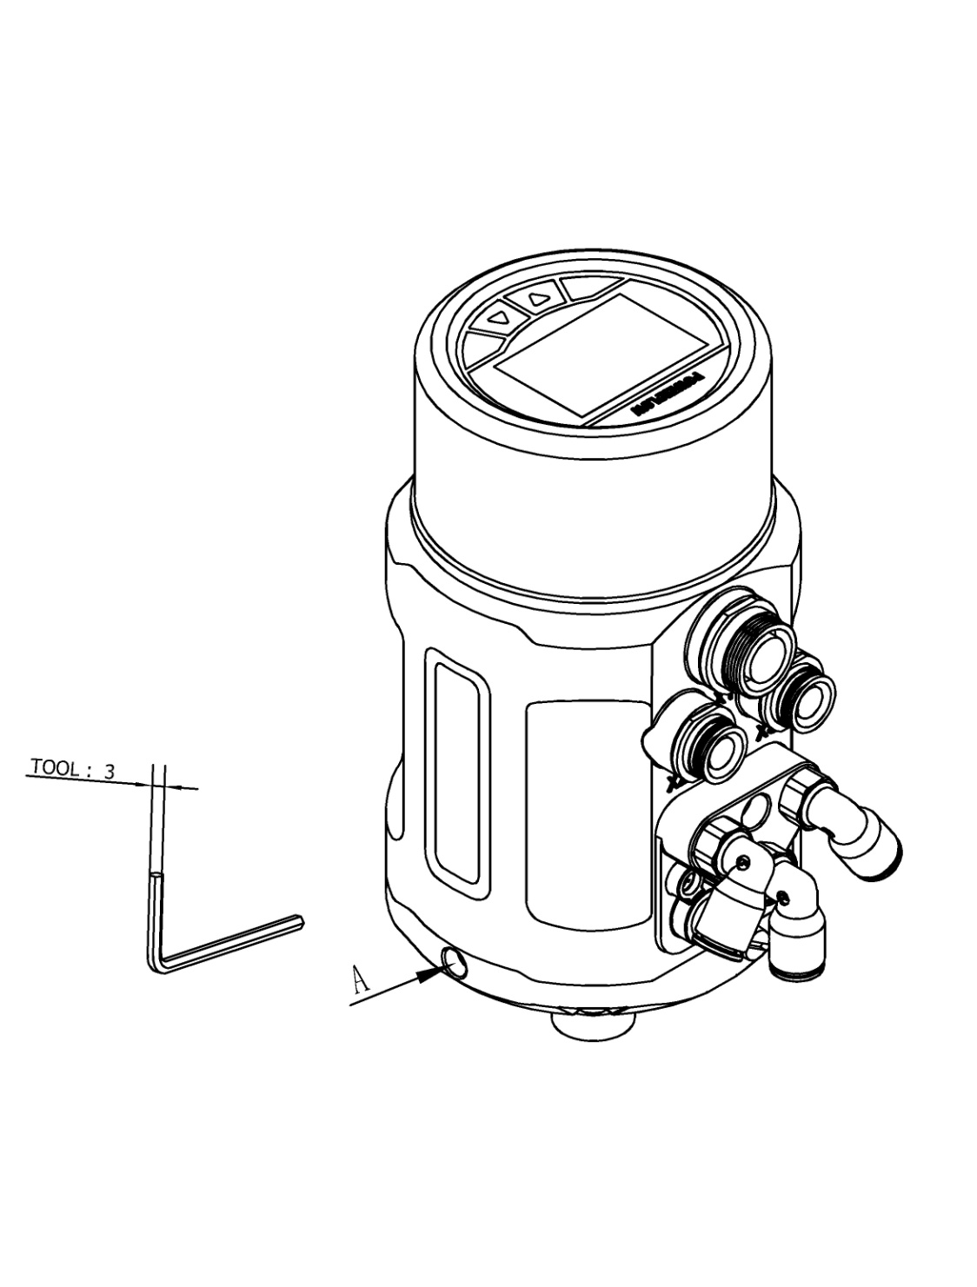
Interface angle adjustment
The angel can be adjusted between the positioner and the valve.If need to adjust the interface angle,relaxing the hexagon screw in place A first.Then adjusting the angle clockwise or counter-clockwise in 180°range. After adjusting the angle, locking the angle by the hexagon screw.
180°
180°

Slide 6
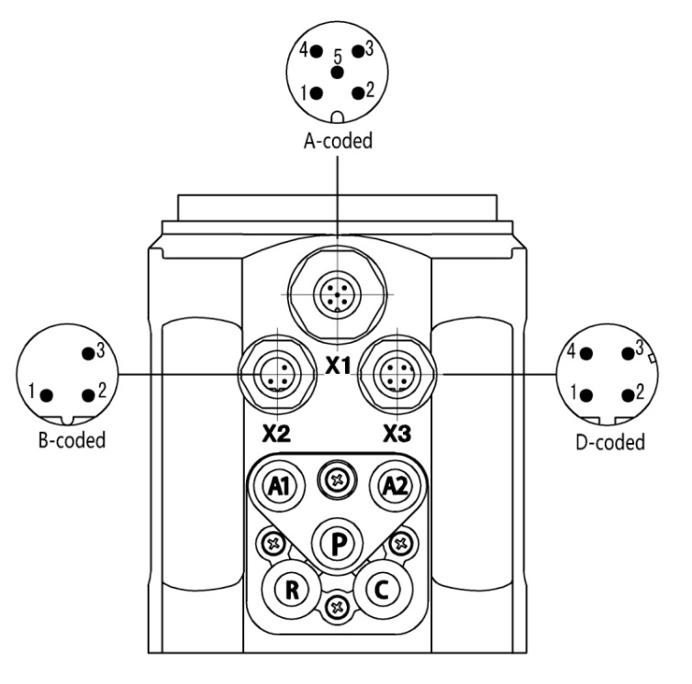
Electrical connections
X2 (1601)
Pin | Description | Signal type
1 | Transmitter input + | +24 V
2 | Transmitter signal output | 4-20 mA
3 | Transmitter GND | GND
X3 (1600/1601)
Pin | Description | Signal type
1 | Power supply + | +24 V
2 | Power supply GND | GND
3 | Set signal input + | 0/4 – 20 mA or 0 – 5/10 V
4 | Set signal input GND | GND
X3 (1602)
Pin | Description | Signal type
1 | Power supply + | +24 V
2 | Power supply GND | GND
3 | / | /
4 | / | /
X1 (1602)
Pin | Description
1 | Bus power supply +5 V
2 | B Inverting driver output/receiver input
3 | A Noninverting driver output/receiver input
4 | DE Driver enable status output
5 | Bus GND
X1 (1600/1601)
Pin | Description | Signal type
1 | Analogue signal output + | 0/4 – 20 mA or 0 – 5/10 V
2 | Binary signal output 1 | 0/24 V
3 | Binary signal output 2 | 0/24 V
4 | Binary signal input + | 0-3V =“0”, 15-30V =“1”
5 | Signal common GND | GND

Slide 7
Pneumatic connections
P | Air supply enter(built-in filter, filter size 5 μm)
R | Air exhaust
C | Check valve
A1 | Pilot air outlet 1
A2 | Pilot air outlet 2
Signal flow diagram
B1
Z1
Valve opening
CMD
Xd1
E1
Position setpoint
Positioner
Pilot valve system
Control valve
Position control loop
Position sensor system
Z2
Process variable
SP
Xd2
CMD
Position control loop
Process set-point value
Process controller
Process
PV
Process control loop
Transmitter

Slide 8
Additional software functions
Selection of the transfer characteristic between set-point value and stroke.
Sealing function for position controller.
Effective sense of direction between input signal and set-point value.
Limit of the mechanical stroke range.
Setting for control parameters.
Safety position setting for the position controller.
Configuration of signal level fault detection.
Activating of the binary input.
Configuration of the outputs.
Calibrating the control parameters.
Setting for manual control rate.
Code protection.
Schematic diagram
Operation through keypad
Inputs
Outputs
Set-point signal
4-20mA, 0-20mA,
0-10V,0-5V
Positioner
1600/1601
Analogue signal
4-20mA, 0-20mA,
0-10V,0-5V
Binary signal􀁔
Binary signal
Process signal
4-20mA
Power supply
24V DC
Operation through keypad
Bus
Positioner
1602
Bus
Power supply
24V DC

Slide 9
Function comparison for all types
FUNCTION | 1600 | 1601 | 1602 | 1500
Explosion-proof | √ | √ | × | ×
Process control | × | √ | × | ×
4-20mA signal input | √ | √ | × | √
4-20mA signal output | ○ | ○ | × | ○
Autotune | √ | √ | √ | √
Valve position manual adjustment | √ | √ | √ | √
Sealing function | √ | √ | √ | √
Dead band setting | √ | √ | √ | √
4-20mA input signal error detection | √ | √ | × | √
Factory setting | √ | √ | √ | √
Characteristic curve setting | √ | √ | √ | ×
Direction of set-point value | √ | × | √ | ×
Valve stroke range limiting | √ | √ | √ | ×
Safety position setting | √ | √ | × | ×
Binary signal input/output | √ | √ | × | ×
Input signal calibration | √ | √ | × | ×
Speed setting of manual adjustment | √ | √ | √ | ×
Code protection | √ | √ | √ | ×
√ | YES
× | NO
○ | optional

Slide 10
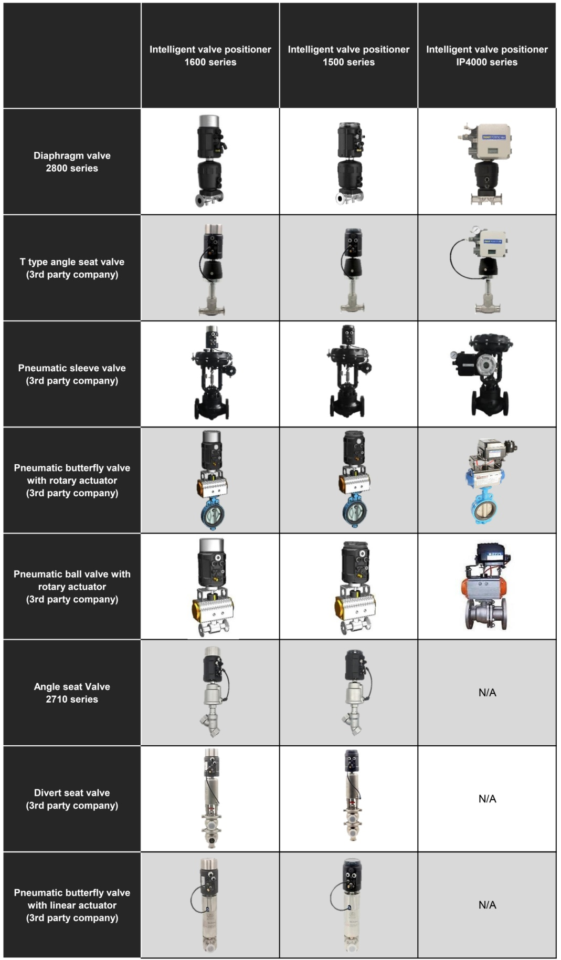
Valve match

Slide 11
1600系列智能电气阀门定位器
1600 位置控制器
1601 过程控制器
1602 位置控制器(Profibus-DP)
不锈钢外壳设计
电气防水接头
带背光液晶显示屏
快速简易启动
丰富的附加功能
技术参数
材料 | 聚碳酸脂（PC）硅橡胶(SI) 聚酰胺(PA6-GF30）不锈钢(304)
电源 | 直流 24V ±10%
信号输入(1600/1601) | 0/4 to 20mA 或 0 to 5/10 V
设定信号输入阻抗(1600/1601) | 0/4-20mA信号时 240Ω 0-5/10V信号时 21KΩ
压缩空气要求 颗粒度要求 颗粒密度要求 凝点要求 油脂浓度要求 | 固体颗粒大小和密度 3 级 露点 3 级 含油量 3 级
环境温度 | 0-70°C
气动接头 | 1/4英寸插入式软管接头(内径Φ 6mm)
电气快速接头 | M12 三针 B标准(电缆直径ø 4-6mm) M12 四针 D标准(电缆直径ø 4-6mm) M12 五针 A标准(电缆直径ø 4-6mm)
气源压力 | 3-7 bar，具体值视执行机构而定
气体输出流量 | 17 l/min(输入压力为0.6Mpa) 58 l/min(输入压力为0.6Mpa, 仅单作用)
阀门行程控制范围 | 直行程 5-50 mm 角行程 90°
安装方式 | 倾向于安装在执行器顶端，通过螺纹和执行器连接
防护等级 | IP66
功耗 | <5W
防爆等级(1600/1601) | Ex nA II C T4
1600系列智能电气阀门定位器是专为一体式气动调节阀所设计的，特别适用于角座阀和隔膜阀产品。
该产品操作简便，软件功能丰富，可轻松通过液晶屏和按键面板进行操作。
定位器可通过检测位移传感器信号，对阀位进行快速精确调节。

Slide 12

组合方式
隔膜式调节阀
角座式调节阀
产品结构
1
液晶屏和按键面板
不锈钢外壳
主壳体
电气接口
气动接口
执行器连接件
2
3
4
5
6

Slide 13
技术规格
1600 不带过程控制功能
带过程控制功能
不带过程控制功能(Profibus-DP)
产品系列
N 无反馈信号
Y 4-20mA反馈信号
反馈信号
S 单作用
D 双作用
执行机构类型
S2 直行程5-25 mm
S3 直行程25-50 mm
S4 角行程 90°
阀门最大行程
Q1 17 l/min
Q2 58 l/min
输出气体流量
T1 G1/4
T2 M16 * 1
T3 M22 * 1.5
T4 M26 * 1.5
螺纹规格
S 复位
F 保位
单作用断电状态
1600
N
S
S2
Q1
T1
S
备注：
输出气体流量选项中，代码Q1建议匹配气室内径40-100 mm 的执行器，代码Q2建议匹配气室内径 125-160 mm的执行器。代码Q2仅适用于单作用执行器，且断电时只支持保位状态。代码Q1,Q2标注的气体流量均为输入压力在0.6Mpa下的气体流量。
阀门最大行程选项中代码S4适用的AT执行器范围是AT50~AT125。其他型号请客户咨询我司。如果选择代码S4，则螺纹规格选项不需要选择。
单作用断电状态默认为复位。1602不支持4-20mA反馈信号。

Slide 14
机械尺寸

Slide 15
操作界面角度调整
将定位器与阀门连接之后，定位器可与阀门之间做角度调整。若需要调整定位器操作界面角度，松开A处的内六角紧定螺钉后，顺时针或逆时针180°范围内调整到需要的角度，再拧紧紧定螺钉。
180°
180°

Slide 16
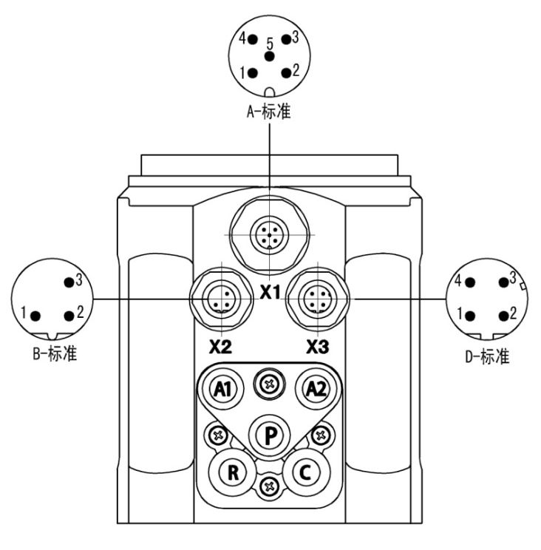
电气接口
X2 (1601)
端子号 | 描述 | 信号类型
1 | 变送器输入 + | +24 V
2 | 变送器信号输出 | 4-20 mA
3 | 变送器 GND | GND
X3 (1600/1601)
端子号 | 描述 | 信号类型
1 | 电源 + | +24 V
2 | 电源GND | GND
3 | 设定信号输入 + | 0/4–20mA 或0–5/10 V
4 | 设定信号输入GND | GND
X3 (1602)
端子号 | 描述 | 信号类型
1 | 电源 + | +24 V
2 | 电源GND | GND
3 | / | /
4 | / | /
X1 (1600/1601)
端子号 | 描述 | 信号类型
1 | 模拟信号输出 + | 0/4–20mA 或0–5/10 V
2 | 开关量信号输出通道1 | 0/24 V
3 | 开关量信号输出通道2 | 0/24 V
4 | 开关量信号输入 + | 0-3V =“0”，15-30V =“1”
5 | 信号公共 GND | GND
X1 (1602)
端子号 | 描述
1 | 总线电源+5V
2 | B 反相驱动器输出/接收器输入
3 | A 同相驱动器输出/接收器输入
4 | DE 驱动器启用状态输出
5 | 总线GND

Slide 17
气动接口
P | 气源进入（内置滤网，过滤尺寸5μm）
R | 排气
C | 单向阀
A1 | 先导气口1
A2 | 先导气口2
信号流程示意图
B1
Z1
阀门开度
CMD
Xd1
E1
位置设定值
位置控制器
先导阀
调节阀
位置控制回路
位移测量系统
Z2
过程量
变化
SP
Xd2
CMD
位置控制回路
过程量设定值
过程控制阀
过程
PV
过程控制回路
变送器

Slide 18
软件附加功能
阀门传输特性设置
紧闭功能设置
输入信号和设定值间的作用方向设置
阀门行程限制
密码保护功能
控制参数的设置
安全位置的设置
输入信号错误检测.
二进制输入信号功能激活
输出信号功能配置
控制参数校正
手动控制速度设置
密码保护
原理图
面板操作
输入
输出
设定信号
4-20mA, 0-20mA,
0-10V,0-5V
定位器
1600/1601
模拟量信号
4-20mA, 0-20mA,
0-10V,0-5V
二进制信号
二进制信号
过程量信号
4-20mA
电源
24V 直流
面板操作
总线
定位器
1602
总线
电源
24V 直流

Slide 19
各型号功能对比
功能 | 1600 | 1601 | 1602 | 1500
防爆 | √ | √ | × | ×
过程控制 | × | √ | × | ×
4-20mA信号输入 | √ | √ | × | √
4-20mA信号输出 | ○ | ○ | × | ○
自整定 | √ | √ | √ | √
手动调节阀位 | √ | √ | √ | √
紧闭功能 | √ | √ | √ | √
死区设置 | √ | √ | √ | √
4-20mA输入信号错误检测 | √ | √ | × | √
恢复出厂设置 | √ | √ | √ | √
特性曲线设置 | √ | √ | √ | ×
信号方向设置 | √ | × | √ | ×
行程限制 | √ | √ | √ | ×
安全位置设置 | √ | √ | × | ×
开关量信号输入/输出 | √ | √ | × | ×
输入信号校正 | √ | √ | × | ×
手动调节速度设置 | √ | √ | √ | ×
密码保护 | √ | √ | √ | ×
√ | 有该功能
× | 无该功能
○ | 可选

Slide 20
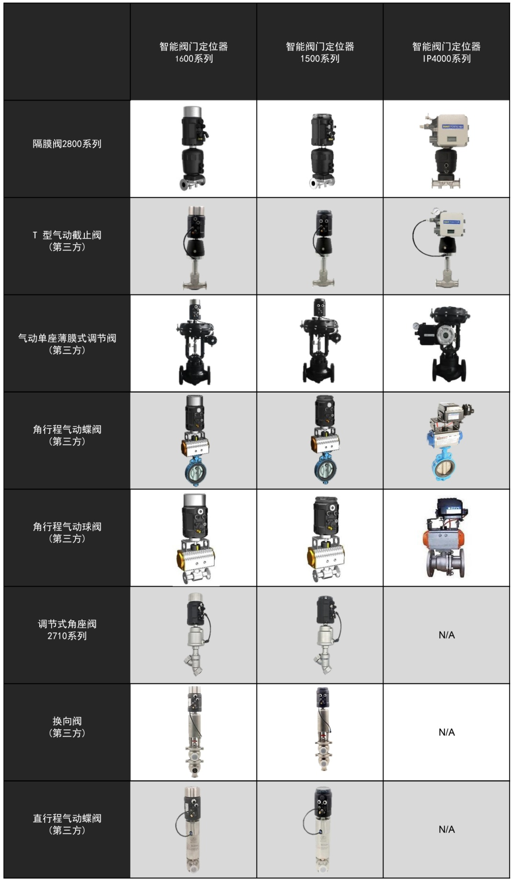
阀门匹配

